Slide 1
Digital Card using Augmented Reality
Team Members:
1. Anuradha Pise
2. Rohini Devkar
3. Kalyani Rajebhosale
4. Ankita Shelke
Guided by:
Dr. Vikas Nandgaonkar

Slide 2
Agenda
1.Aim
2.Literature Survey
3.Motivation
4.Objectives
5.Proposed System
6.H/W and S/W to be used and Overall Cost requirements
7.Planning and Scheduling of Project(Gantt Chart)
8.Risk Involved
9.Social Aspect
10.Conclusion
11.References

Slide 3
Aim
To generate Digital Card with the help of Augmented Reality Technology with the help of web AR and AR.js Framework

Slide 4
Literature Survey
Sr.No | Title of Paper | Year | Author | Key Points
1 | A Survey on Web-based AR Applications | 2011 | Behrang parhizkar , ashraf abbas m. al-modwahi , arash habibi lashkari , mohammad mehdi bartaripou , hossein reza babae | Augmented Reality (AR), web-based Augmented Reality, AR Quality.
2 | Web AR: A Promising Future for Mobile Augmented Reality—State of the Art, Challenges, and Insights | 2019 | Xiuquan Qiao; Pei Ren; Schahram Dustar; Ling Liu; Huadong Ma; Junliang Chen | augmented reality (AR); virtual reality (VR); Web based augmented reality (Web AR).
3 | Effective of augmented reality (ar) in marketing communication | 2016 | elham baratali, mohd helmi bin abd.rahim, behrang parhizkar, zahra mohana gebril | Augmented Reality, Digital Media, Augmented Reality in Marketing , Marketing Communication

Slide 5
Motivations
We believe in the Web, as a collaborative and accessible environment. We also believe in Augmented Reality technology, as a new communication medium, that can help people see reality in new, exciting ways. We see Augmented Reality (AR) used everyday for a lot of useful applications, from art, to education, also for fun.
We strongly believe that such a powerful technology, that can help people and leverage their creativity, should be free in some way. Also collaborative, if possible. And so, we continue the work started by Jerome Etienne, in bringing AR on the Web, as a free and Open Source technology.

Slide 6
Objectives
To generate an AR Digital Card that enables digital information when viewed through a smartphone's camera.
The Card will contain digital content and will be accessible anywhere.
Applying the AR effect on a simple card boosts memory and engagement.
Using digital card will help you branding your products, and yourself come as the top motivation.
Digital card offers the chance to overlay information, images, or other content onto a user's view.
Using AR Card will reduce the need for printing a vast number of cards.

Slide 7
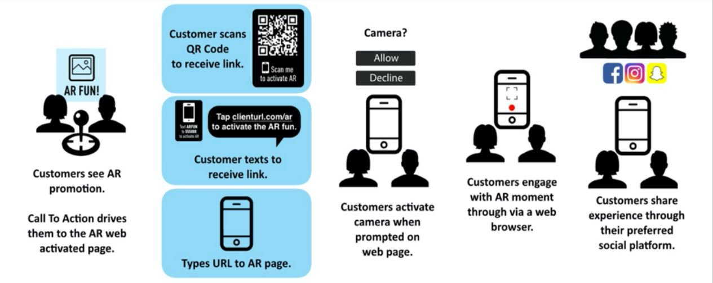
Proposed System

Slide 8
H/W and S/W to be used and Overall Cost Requirement
Hardware/Software Requirements:
It works on every phone with webgl and webrtc.
Marker based tracking is very lightweight, while Image Tracking is more CPU consuming.
Overall Cost of Project:
We use a webAr framework for our project and it is free of cost.

Slide 9
Software Requirements
Sr.No. | Software Component | Details(Technical details with Purpose)
1 | Operating System | Windows 10
2 | Technology | Augmented Reality
3 | Tool | Microsoft Visual Studio
4 | Database | SQL
5 | Programming Languages | HTML, CSS , JavaScript

Slide 10
Hardware Requirements
Sr.No. | Component | Details(Technical details with Purpose)
1 | Processor | 11th Gen Intel(R) Core (TM) i5
2 | Memory | 8GB
3 | Speed | 2.80GB
4 | HardDisk | 40GB

Slide 11


Planning and Scheduling of Project (Gantt Chart)
 | August |  |  |  | September October |  |  |  | November December
Task Month | Week 01 | Week 02 | Week 03 | Week 04 | Week 03 | Week 04 | Week 03 | Week 04 | Week 01 | Week 02 | Week 03 | Week 04
Market Research
Project Selection
Planning
Development
Testing
Final Assessment
Documentation
1st -8th
22nd-26th
27th -30th
10th-28th
1st -20th
27th -5th
1st -14th
Market Team
Planning Team
Development Team
Milestone
Continue

Slide 12
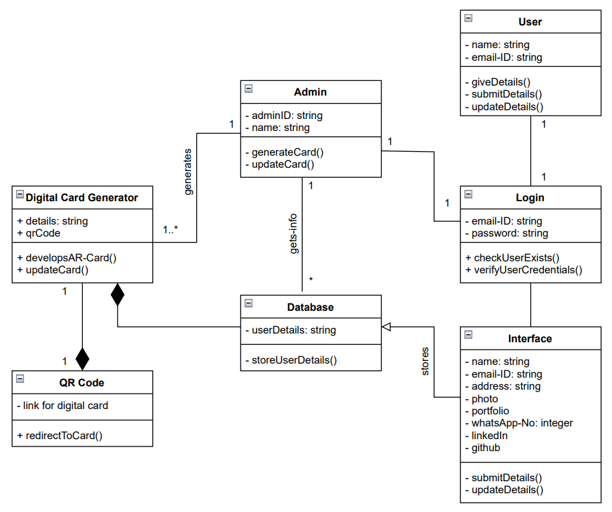
UML diagrams 1) Class Diagram

Slide 13
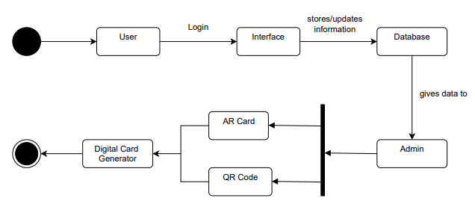
2) Activity Diagram:

Slide 14
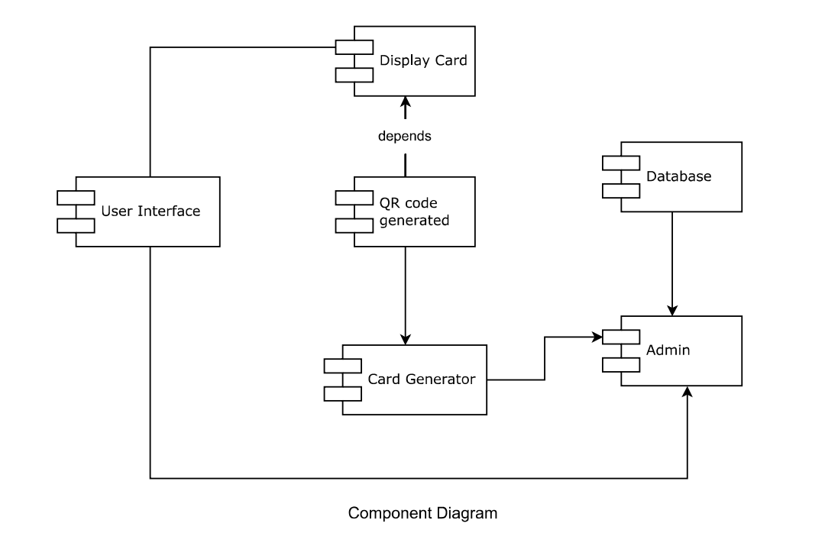
3) Component Diagram

Slide 15
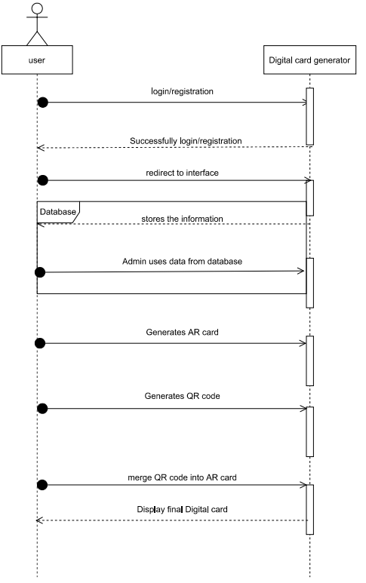
4) Sequence Diagram

Slide 16
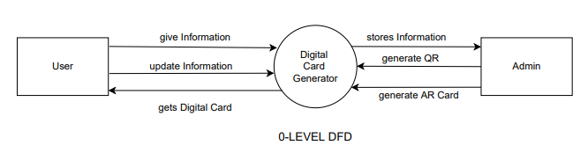
DFD Diagram
DFD Diagrams:-
1) DFD level-0

Slide 17
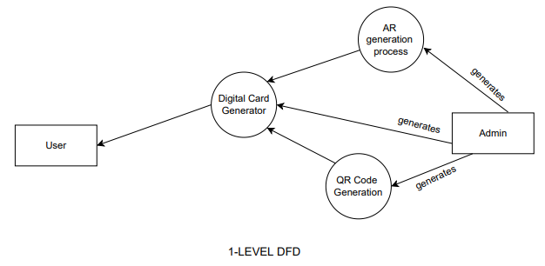
2) DFD level-1

Slide 18
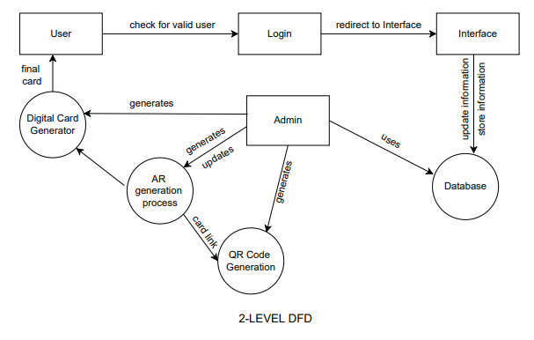
3) DFD level-2

Slide 19
Risk Involved
Buyer side fraud:- One can use fake buyer accounts or id for misuse of digital card.
Cyber security frauds:- Account takeover , identity theft, card details theft.
All time access:- Availability of Internet.

Slide 20
Social Aspect
Communication and Interaction
Business Improvements
Marketing
A less use of Paper
Accessibility for All
Multiple Media Formats to one Paperless Card

Slide 21
Conclusion
Augmented reality cards will replace the traditional paper cards and will acts as your virtual advertisement, bringing people additional valuable content about you, which you couldn't possibly fit onto a regular card.
It'll turn your basic text card into a digital billboard.
You get to add additional content about you, which you couldn’t possibly fit onto a regular card.
This can range from videos about your business to links to your social media, website, and call-to-actions.
The physical design looks very similar to an ordinary card.

Slide 22
References
XIUQUAN QIAO, PEI REN, SCHAHRAM DUSTDAR, Fellow IEEE, LING LIU, Fellow IEEE, HUADONG MA, AND JUNLIANG CHEN “Web AR: A Promising Future for Mobile Augmented Reality—State of the Art, Challenges, and Insights” IEEE Volume 107, Issues 4, page no. 651-666.
ELHAM BARATALI, MOHD HELMI BIN ABD.RAHIM, BEHRANG PARHIZKAR, ZAHRA 6 MOHANA GEBRIL “EFFECTIVE OF AUGMENTED REALITY (AR) IN MARKETING COMMUNICATION; A CASE STUDY ON BRAND INTERACTIVE ADVERTISING” IJMAS Volume 2, Issues 4, page no. 133-137.
BEHRANG PARHIZKAR, ASHRAF ABBAS M. AL-MODWAHI, ARASH HABIBI LASHKARI, MOHAMMAD MEHDI BARTARIPOU , HOSSEIN REZA BABAE “A Survey on Web-based AR Applications” IJCSI Volume 8, Issues 4, page no. 471-479.
JULES WHITE, DOUGLAS C. SCHMIDT, MANI GOLPARVAR-FARD “Applications of Augmented Reality” IEEE Volume 102, Issues 2, page no. 120-123.
Vikas Tiwari, Vijay Prakash Tiwari, Dhruvesh Chudasama, Prof. Kumkum Bala “Augmented Reality and Its Technologies” IRJET Volume 03, Issue 04, page no.1416-1420.
R. Silva, J.C. Oliveira, G.A. Giraldi “Introduction to Augmented Reality” National Laboratory for Scientific Computation Volume 36 , Issues 333, page no. 1-11.

Slide 23
Thank You!

